Slide 1

PECKISH – TASTE THE MYTH GROUP-3

Slide 2
ABOUT THE APP
Restaurant Apps are making food available anywhere and everywhere. Scalability, Affordability and Performance Enhancement are few on the benefits of mobile application development
Our application heavily relies on client-server communication. To provide simplified interface design for client and do the same for the administrator was the challenging part of the application.

Slide 3
FLOW OF THE APP
Customer Places An Order Through App
Restaurant Receives Notification
Customer Order List Updated
Restaurant Prepares Order
Restaurant Notifies Customer That Order Is Ready And Forwards It To Delivery Staff
Customer Is Notified And Food Is Delivered

Slide 4
WHAT HAVE WE LEARNED
Firebase Authentication
Firebase Real Time Database
Firebase UI
Firebase Cloud Messaging
Local Database
SQLite Asset Helper Class
Recycler View

Slide 5
WHAT HAVE WE LEARNED
Picasso Library
Services
Search Bar Optimization
Tokens
Retrofit Library, Retrofit Gson Converter
Bottom Navigation View
App Drawer

Slide 6
FEATURES (CLIENT SIDE)
View Pager just for the first time
Search bar with suggest list
Quick Cart
User Reviews
Notifications(New order, Change in Order(Tokens) )
User Session
Delete from Cart, Change # in cart

Slide 7
FEATURES (CLIENT SIDE)
View Pager just for the first time
Search bar with suggest list
Quick Cart
User Reviews
Notifications(New order, Change in Order(Tokens) )
User Session
Delete from Cart, Change # in cart

Slide 8
FEATURES (SERVER SIDE)
Manage Orders
Add new items
Make Changes to Items

Slide 9
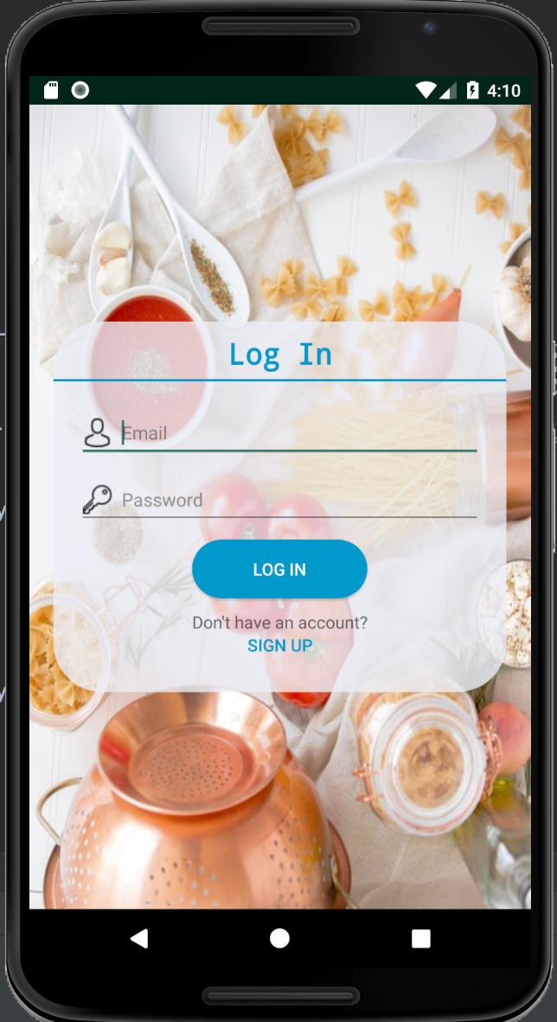
FIREBASE AUTHENTICATION
Knowing a user's identity allows an app to securely save user data in the cloud and provide the same personalized experience across all of the user's devices.
We have used firebase authentication services in order to validate user credentials.

Slide 10
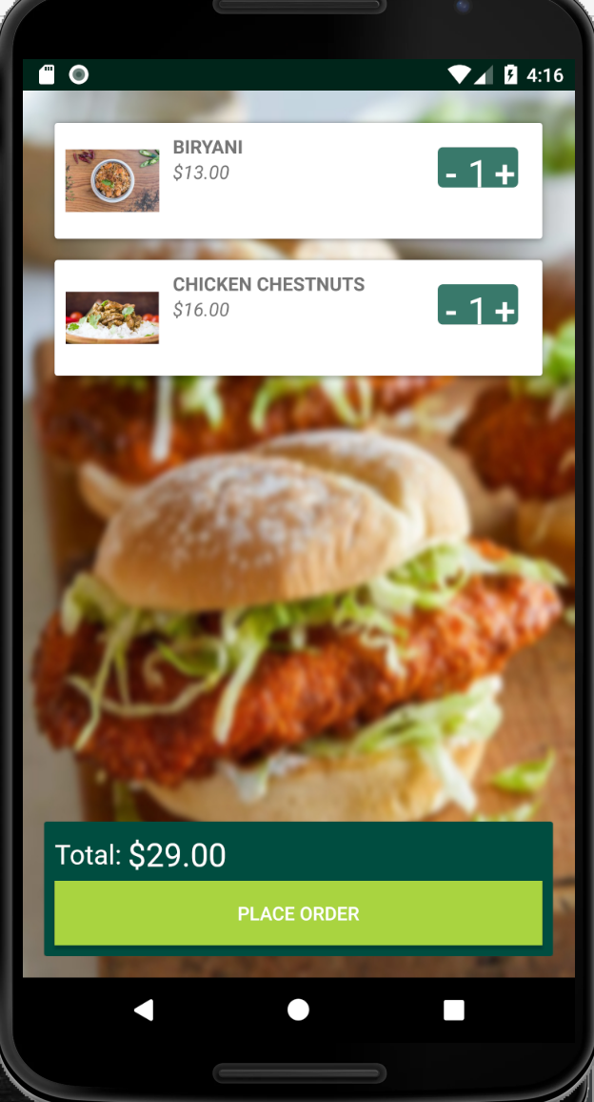
LOCAL DATABASE
Local databases can be useful in the situations where you have to restrict server calls and make sure that request are sent to the server only when it’s necessary
We have used local databases to store user favorites, cart items and reviews.

Slide 11
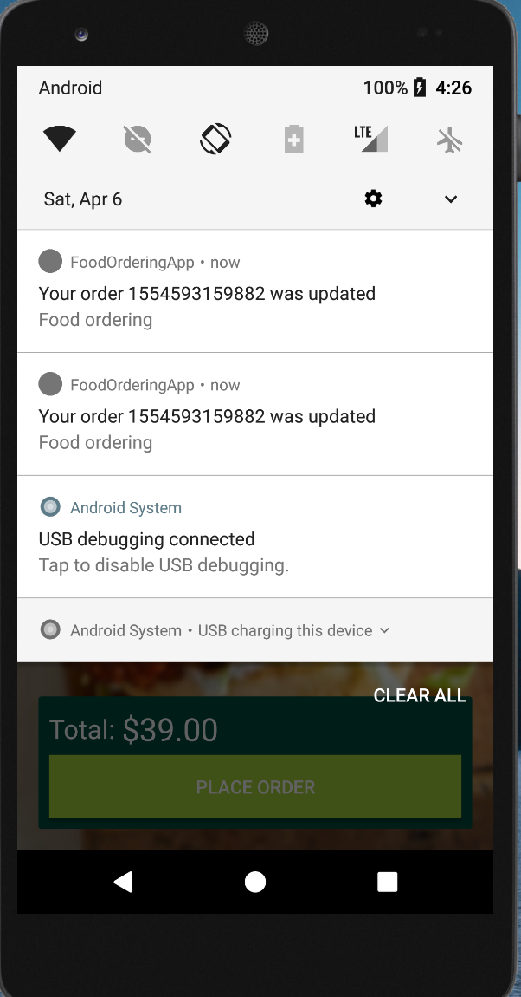
FIREBASE CLOUD MESSAGING
Firebase Cloud Messaging (FCM) is a cross-platform messaging solution that lets developer to reliably deliver messages at no cost.
In our application, notifications play very important role. In order to make those notification appear on user screen with minimum delay integration of FCM was crucial.

Slide 12
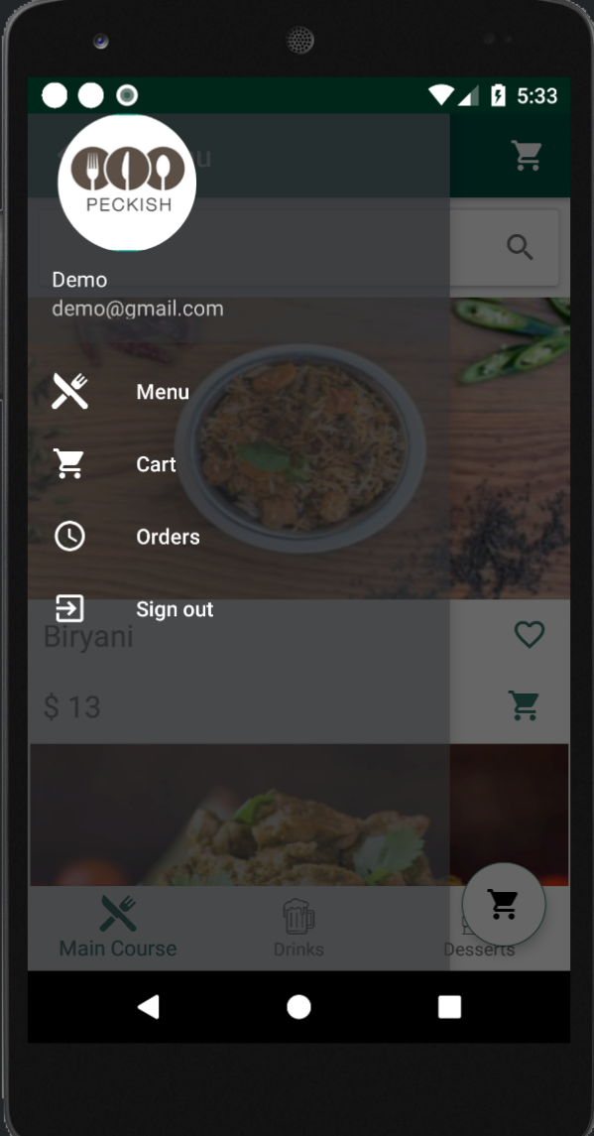
NAVIGATION ELEMENTS
Navigation refers to the interactions that allow users to navigate across, into, and back out from the different pieces of content within your app.
To make sure that all the user can access all the functionality regardless of the activity he’s currently in, we have implemented navigation drawer and bottom navigation menus.

Slide 13
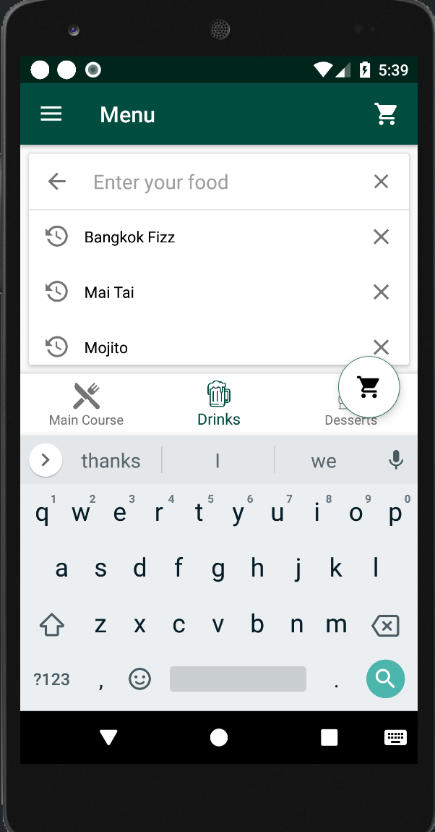
SEARCHBAR OPTIMIZATION
Search bar optimization was necessary as we wanted to display recommendation when user clicks on the search bar and as soon he starts typing, list should be updated to match users search query.
In addition to that we were able to implement functionality which is very specific to the navigation. For ex. If user search when he is on drinks menu , all the possible results that are available in the drinks menu are displayed.

Slide 14
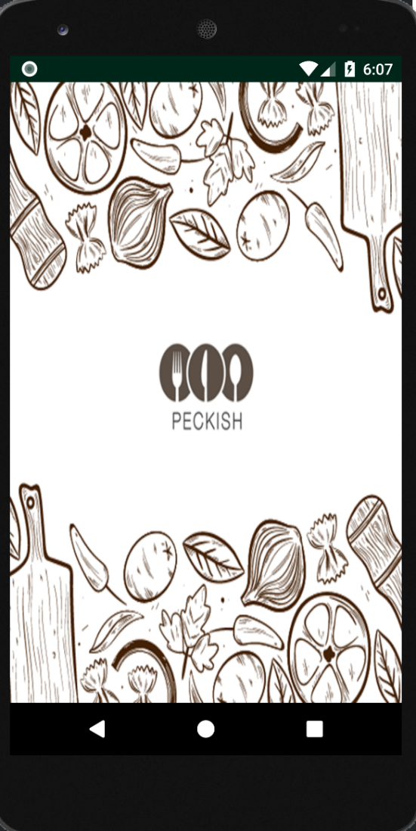
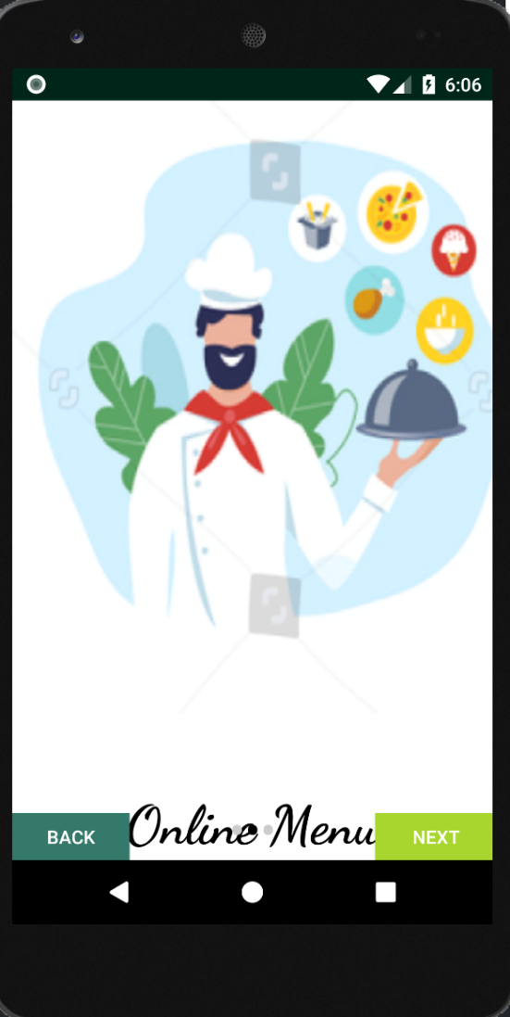
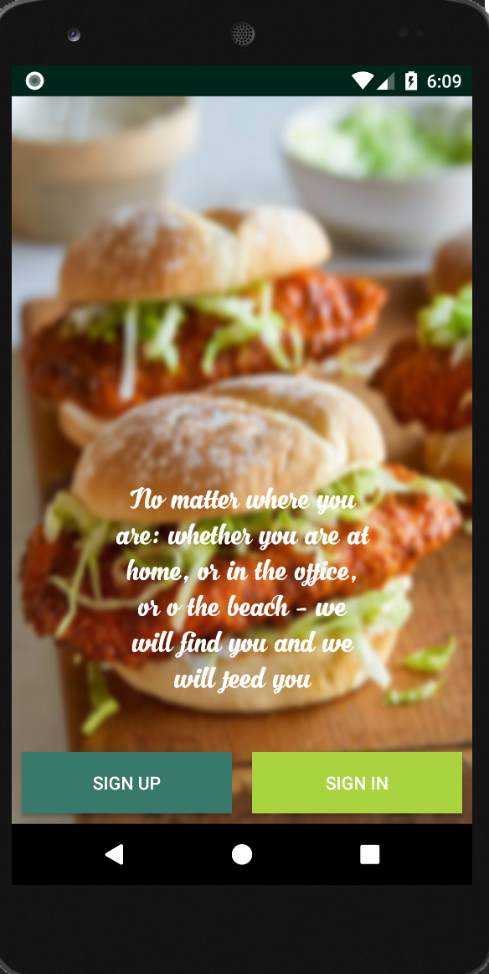
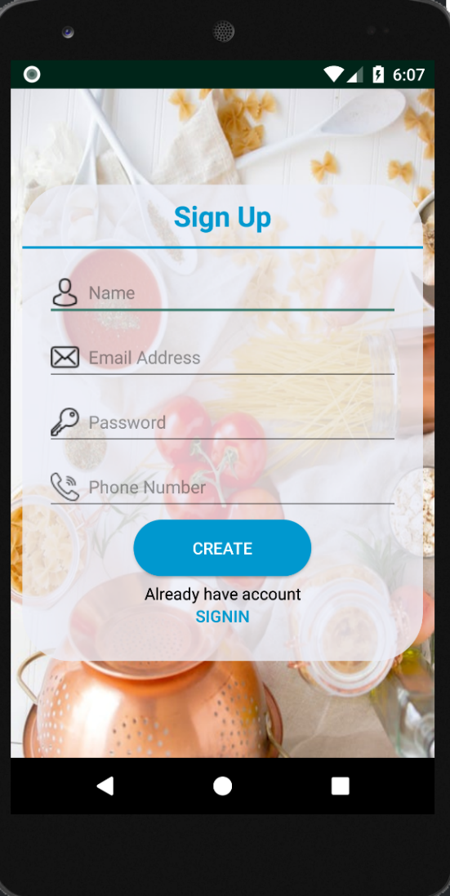
SPLASH ACTIVITIES

Slide 15
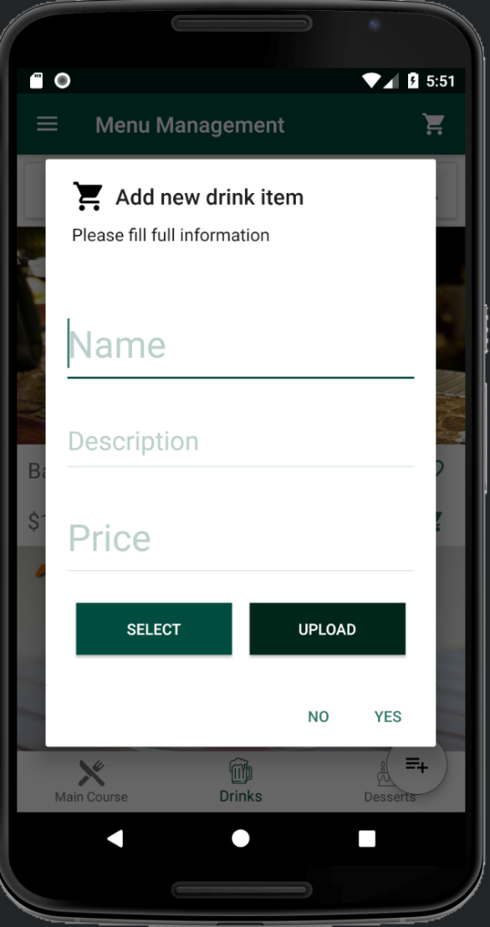
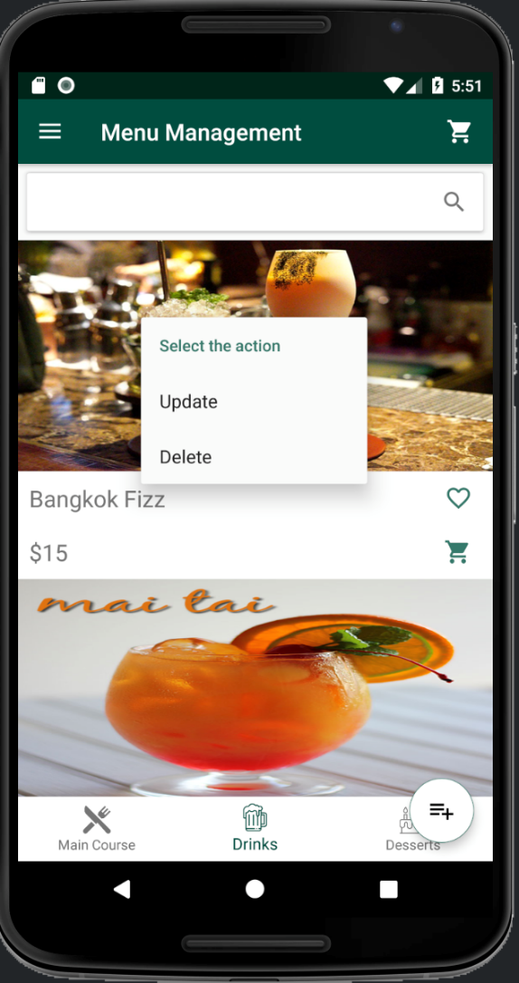
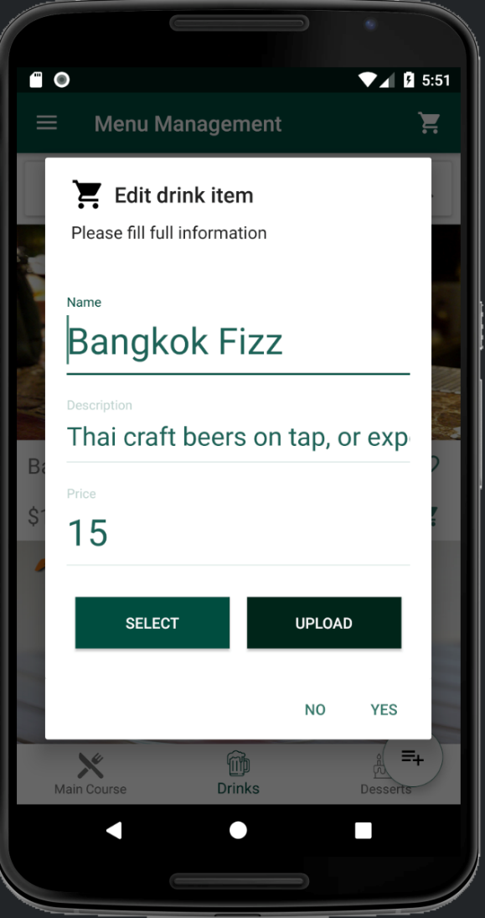
ADDITIONAL FUCNTIONS (SERVER SIDE)

Slide 16
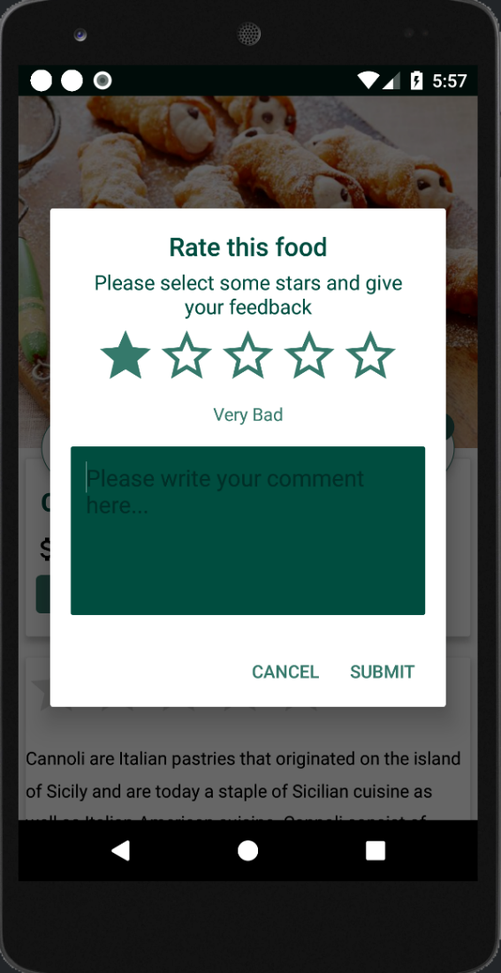
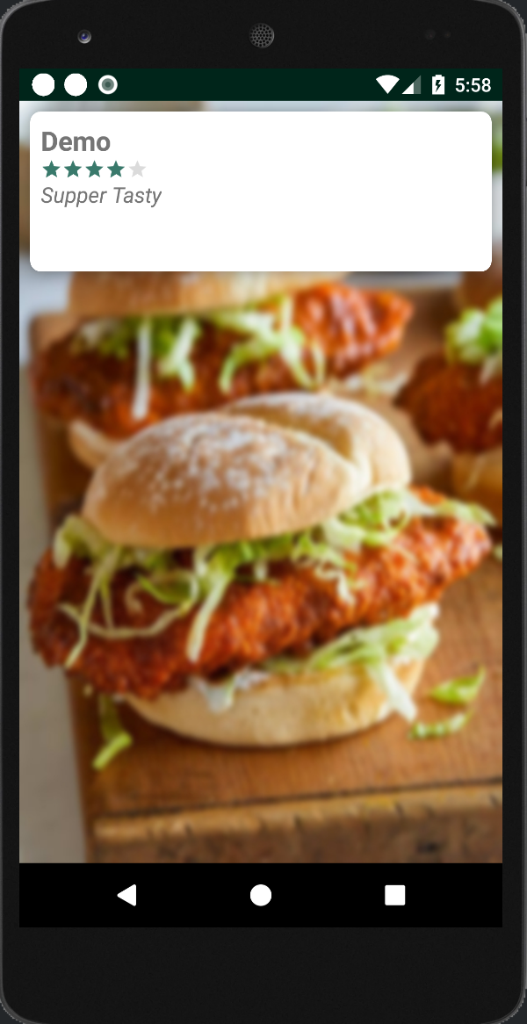
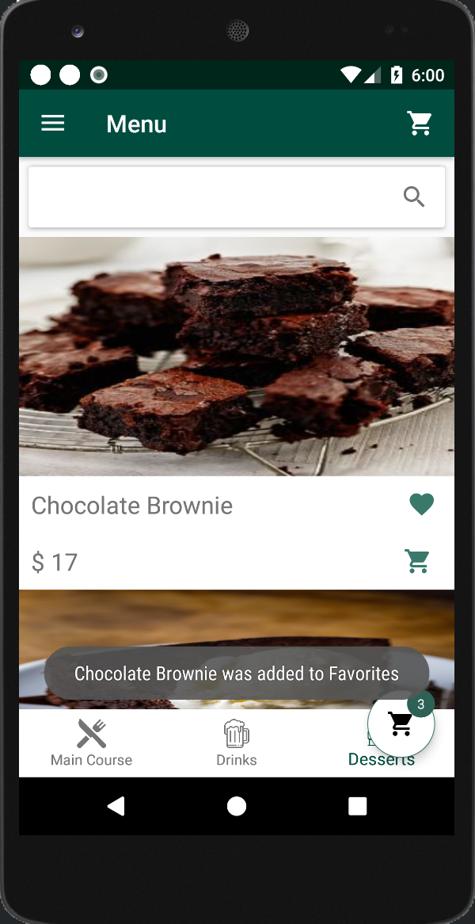
ADDITIONAL FUCNTIONS (CLIENT SIDE)

Slide 17
RETROFIT CLIENT LIBRARY
Retrofit is a REST Client for Android and Java by Square. It makes it relatively easy to retrieve and upload JSON (or other structured data) via a REST based web service.
In Retrofit you configure which converter is used for the data serialization. Typically for JSON you use GSon, but you can add custom converters to process XML or other protocols. It uses the OkHttp library for HTTP requests.

Slide 18
RETROFIT CLIENT LIBRARY
To work with Retrofit you need basically three classes.
1) Model class which is used to map the JSON data to
2) Interfaces which defines the possible HTTP operations
3) Retrofit.Builder class - Instance which uses the interface and the Builder API which allows defining the URL end point for the HTTP operation.

Slide 19
PICASSO LIBRARY
Images add much-needed context and visual flair to Android applications. Picasso allows for hassle-free image loading in android application.
Many common pitfalls of image loading on Android are handled automatically by Picasso:
- Handling ImageView recycling and download cancelation in an adapter.
- Complex image transformations with minimal memory use.
- Automatic memory and disk caching.

Slide 20
INTO THE FUTURE
While we have implemented a lot of features in this application, there are few functionalities that we are aiming to integrate in future:
Payment Gateway Integration
Google Maps UI
Text and Email Notifications
Google Login Integration
Recipes Section

